Slide 1
mESSAGEme!
Team
Venkatesh Bonageri
Vikas Deshpande
Sai Nishanth Dilly

Slide 2
App features
Login and signup functionalities.
Inbox activity for users to get list of all messages.
User can read, delete and reply to selected message.
User can compose message to other users from the list.
Beacon region which unlocks the message so the message becomes readable inthe inbox list.

Slide 3
Design Concepts
Front End: Android
API: Node JS
DB : MySQL
Authentication/Session Management : JWT
Hosted Server : Amazon AWS EC2

Slide 4
Tasks Completed
Login and Signup Activity.
1
Inbox Activity - Loading and Parsing Messages.
2
Read Message Activity.
3
Compose Message Activity.
4
Hosted on Amazon EC2
5

Slide 5
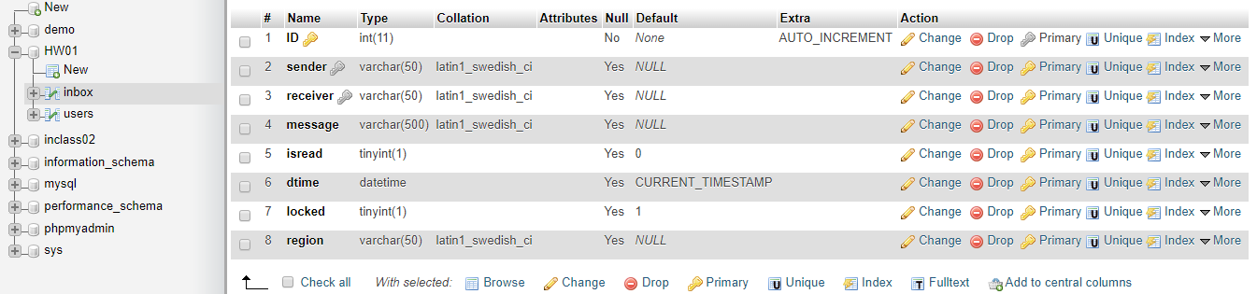
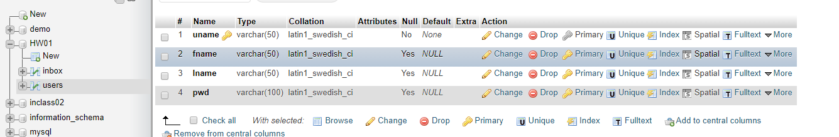
Inbox and Users table

Slide 6
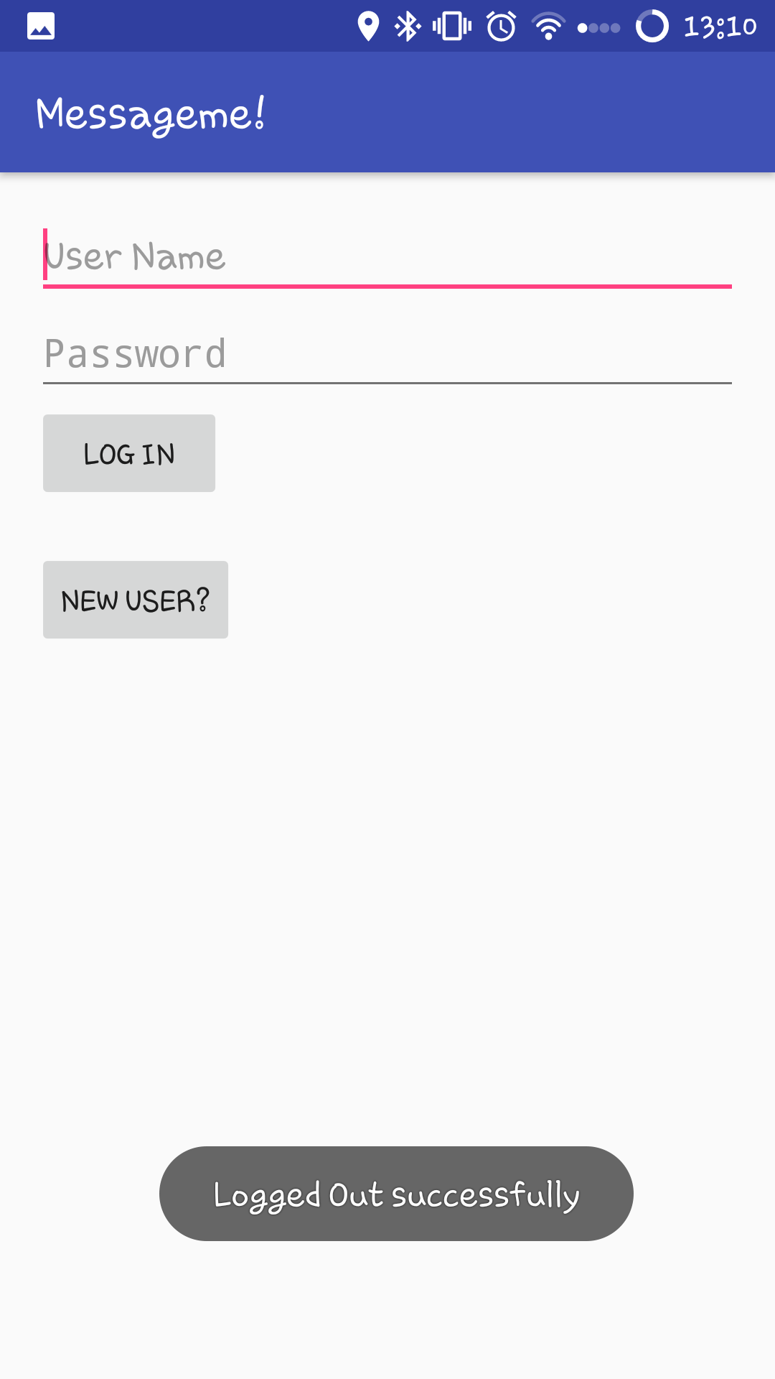
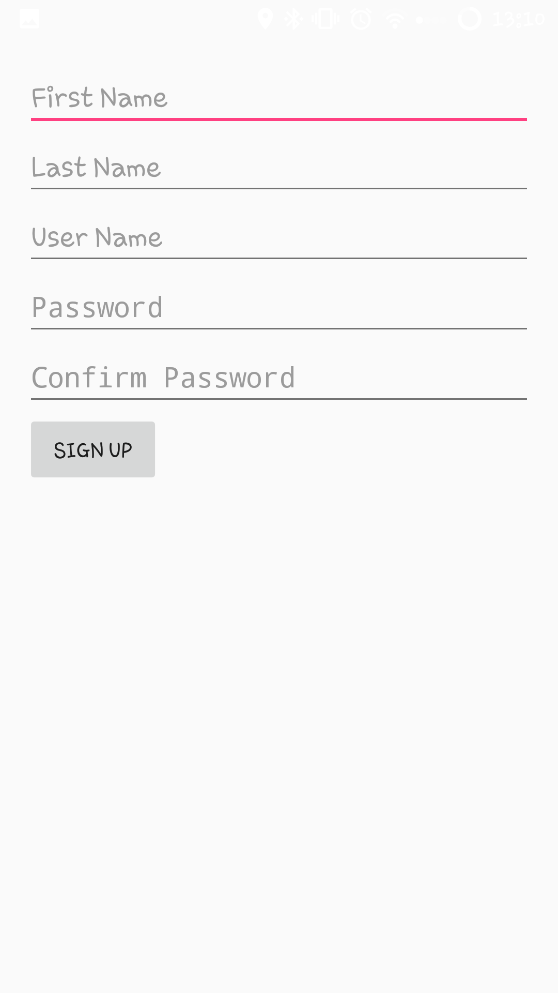
Login AND SIGNUP

Slide 7
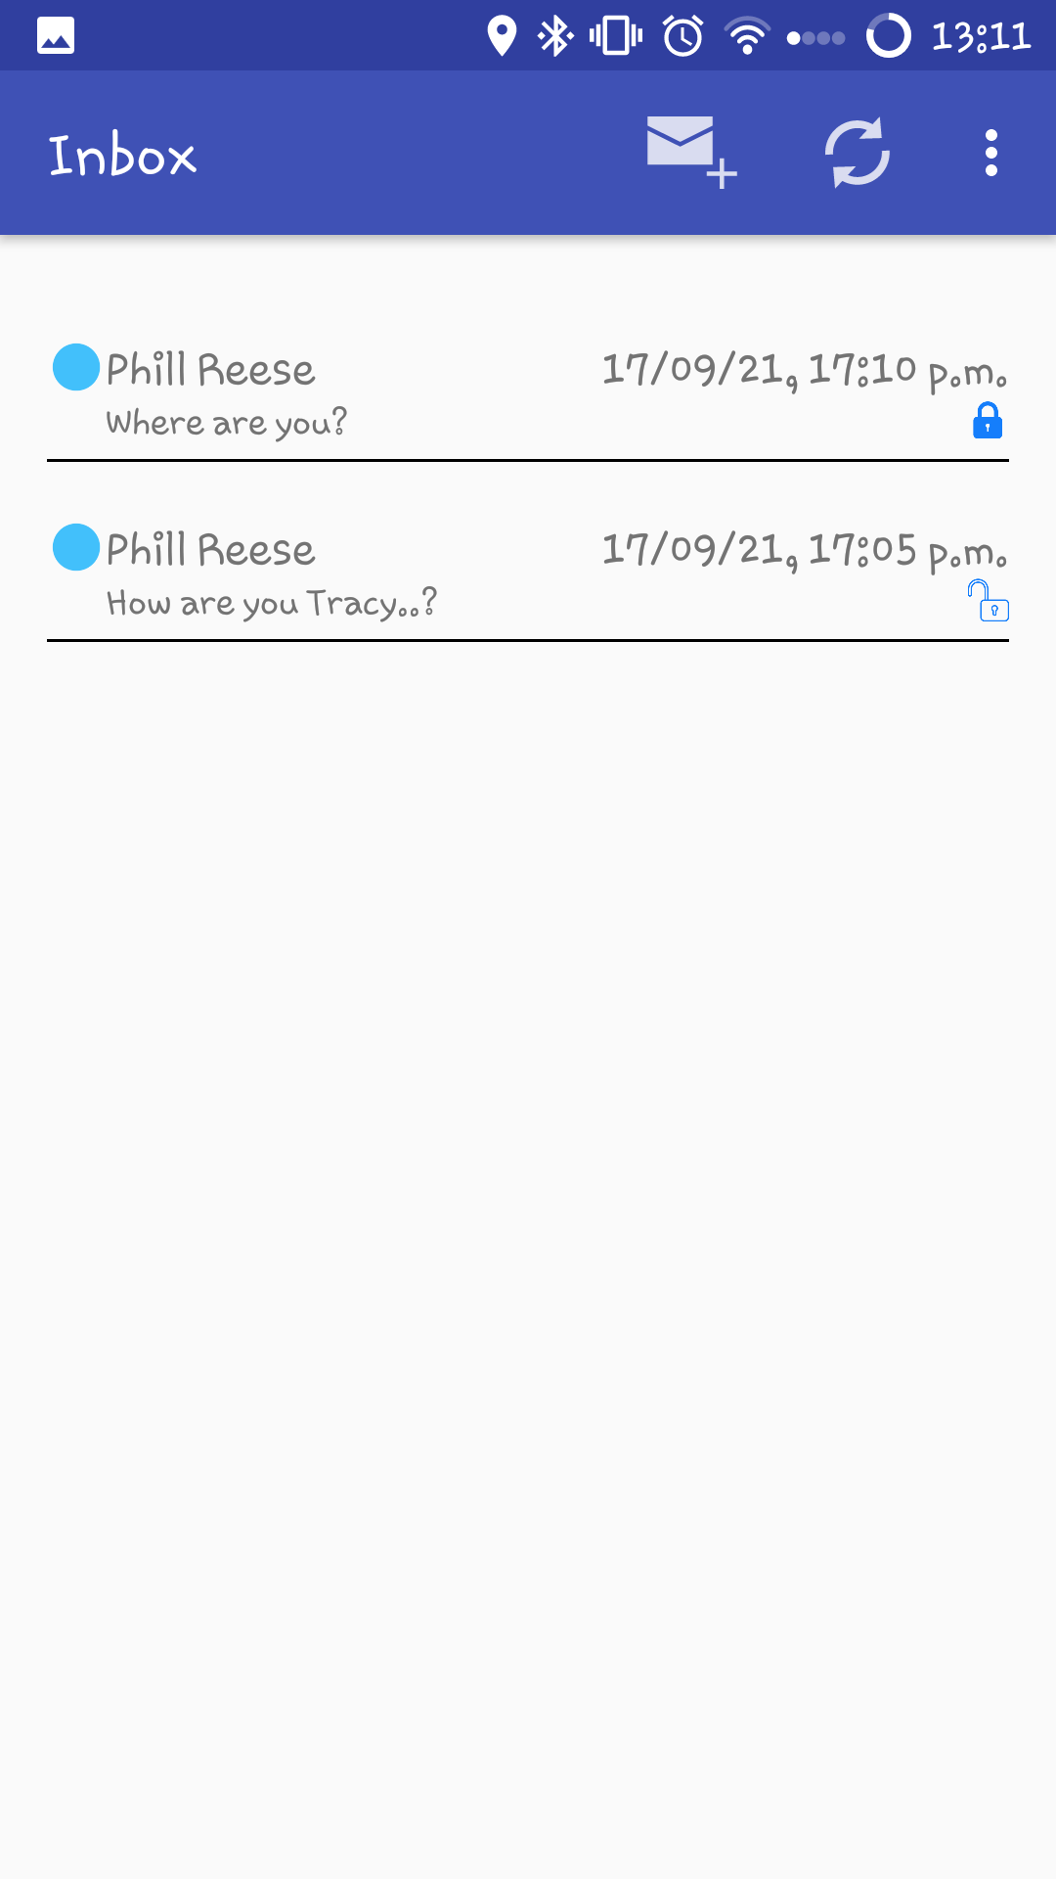
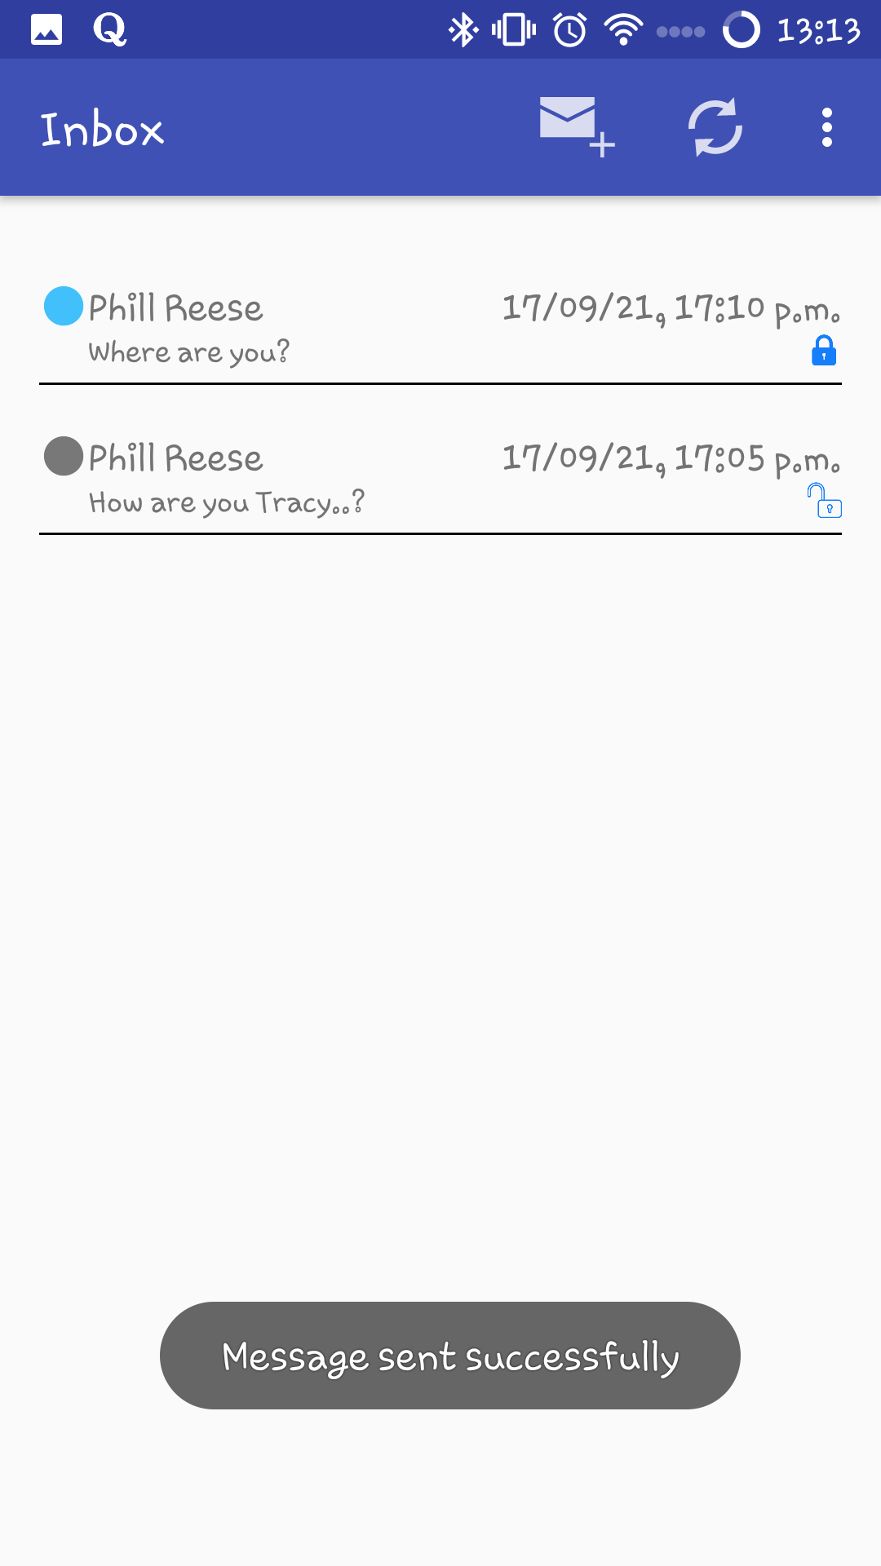
Inbox Activity - Loading and Parsing Messages.

Slide 8
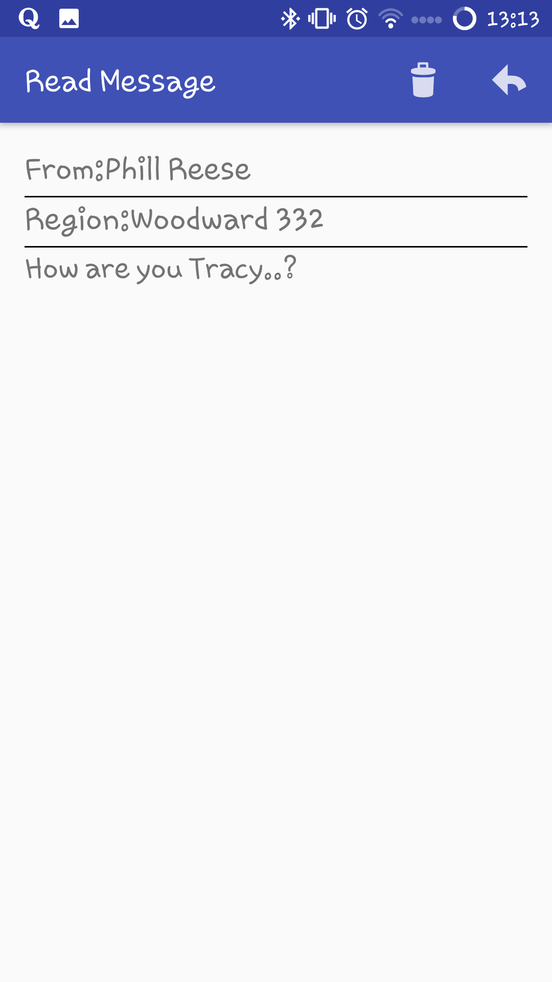
Read Message Activity.

Slide 9
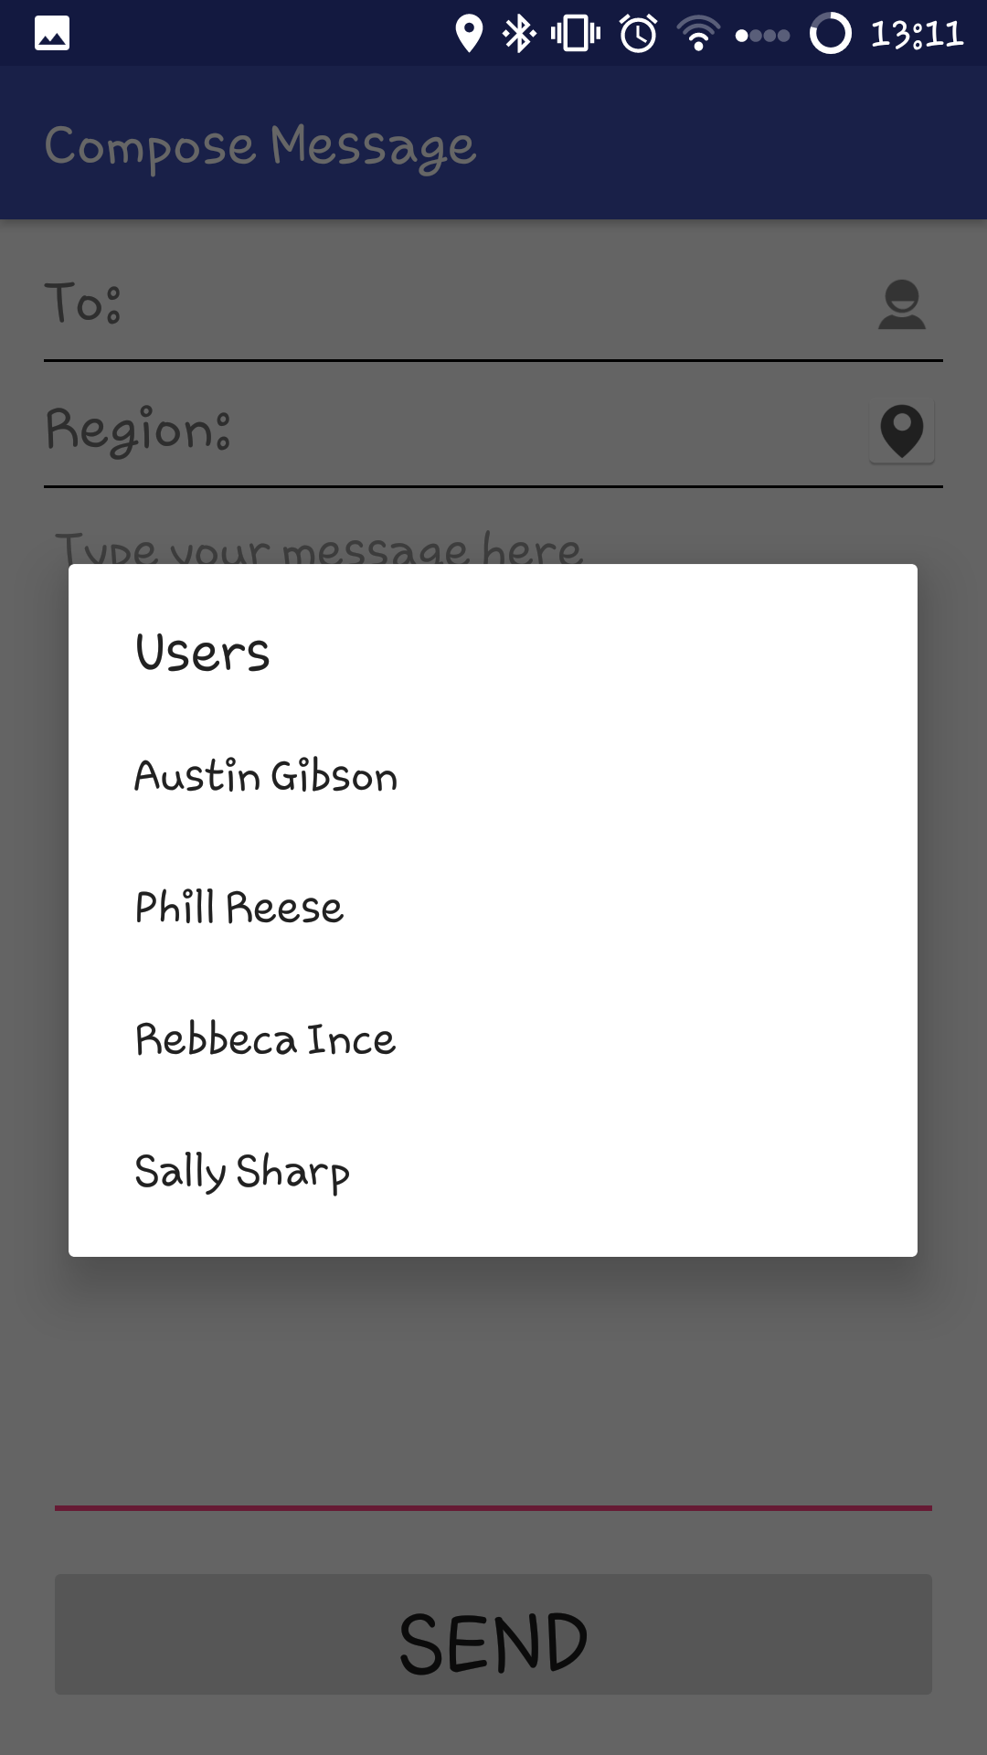
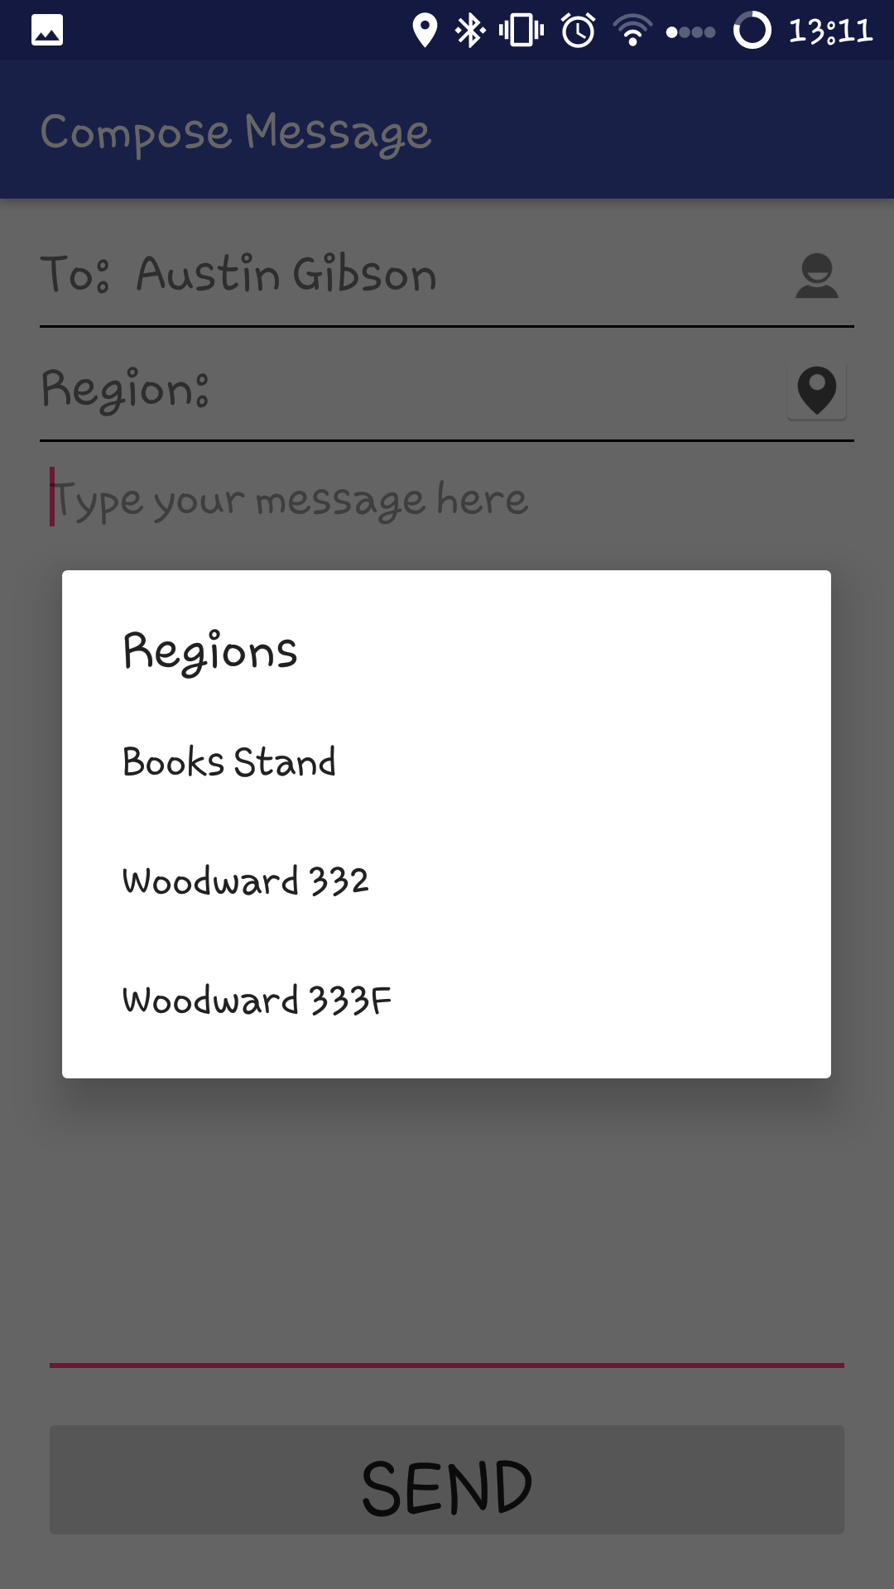
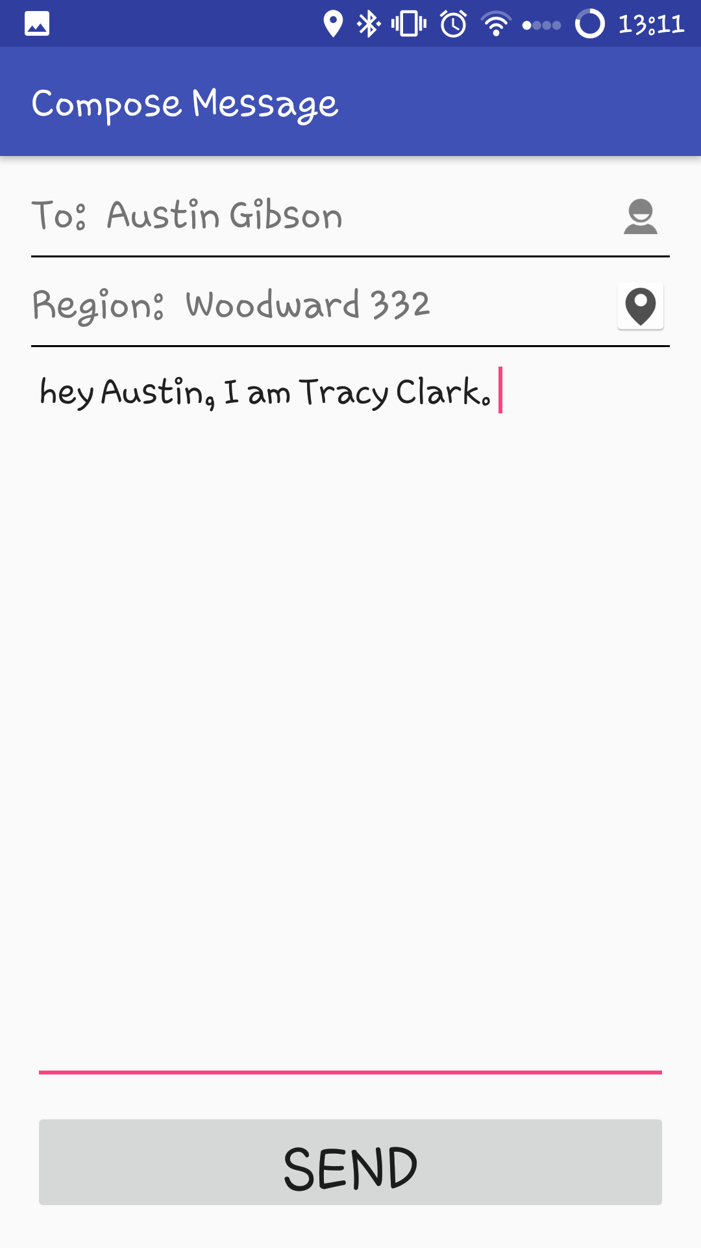
Compose Message Activity.
List of Users
List of Regions
User and Region selected, message body entered

Slide 10
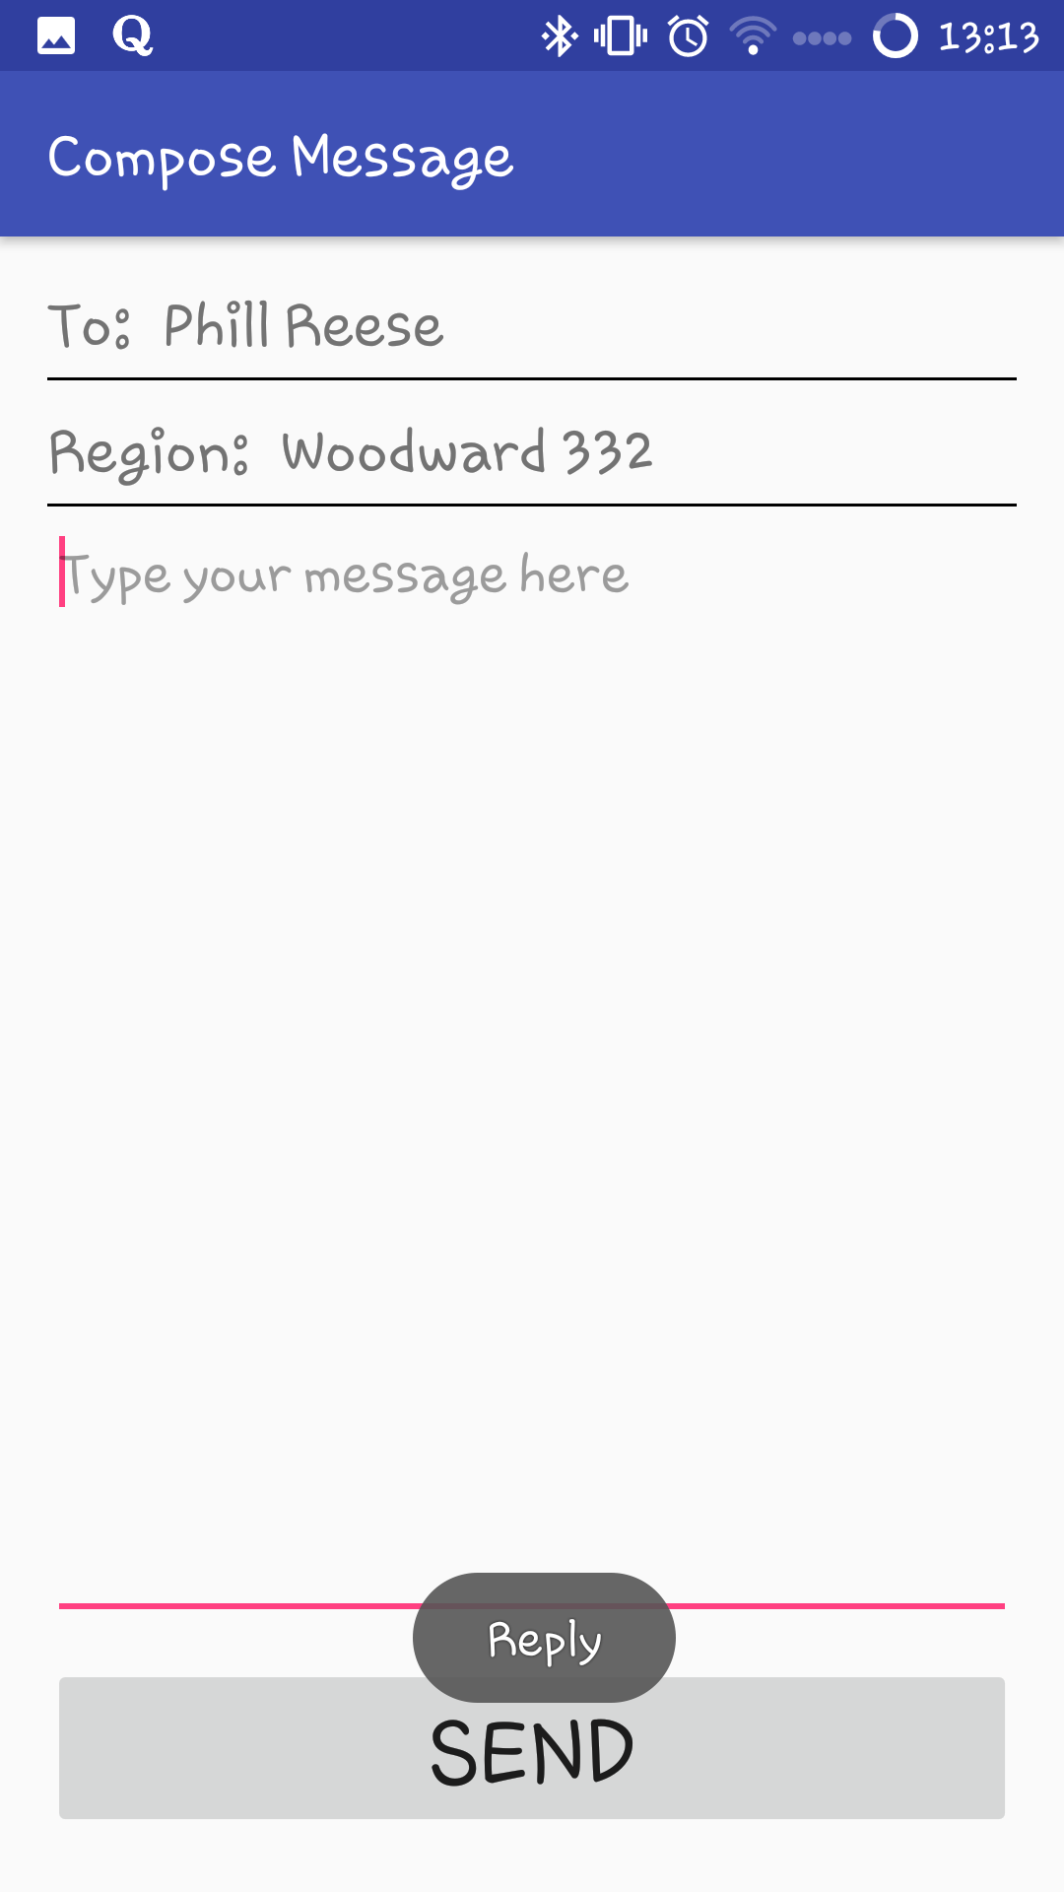
Compose Message Activity (From Read Message Activity)
Compose Message Activity called from Read Message Activity, replying to a person’s message directly, both To and Region fields filled by default.

